Slide 1
Rights in relationships

Slide 2
Learning objectives and outcomes
Learning objective:
To understand the key concepts of human rights and their importance in our lives and relationships.
Learning outcomes:
I can assess whether specific human rights have been broken in different relationship situations
I can identify who could support a young person if their rights are being broken
I can explain factors that make it hard to uphold rights in relationships and analyse how to overcome these

Slide 3
Ground rules
Use language that will not offend or upset anyone.
When you give an opinion, try to explain your reasons.
Listen to the views of others and show respect.
If you disagree, comment on what was said, not the person who said it.
Do not share personal information about other people.
If you’re worried about something that has happened to you or a friend, talk to a member of staff or an adult you trust after the session.
If a member of staff becomes aware of a risk to a young person’s safety, this information may need to be shared.

Slide 4
What rights do you think all young people should have?
Create a mind map with your ideas.

Slide 5
Human rights and children’s rights
Human rights are the things people are all entitled to simply because they are human beings
In 1948, the United Nations adopted the Universal Declaration of Human Rights
It sets out the fundamental human rights that should be protected, and has been accepted by most countries around the world
These rights are universal – they apply to everyone equally in every part of the world, whoever they are, whatever their age, gender, ethnicity, sexuality
The UN Convention on the Rights of the Child sets out further rights that are specific to young people
All children and adults are also entitled to their human rights in all online environments, as the internet is just another public place

Slide 6
Key human and children’s rights
Every child has the right to an identity
Every child has the right to privacy
Children have the right to live free from (and be protected from) all forms of abuse and exploitation
Every child has the right to think and believe what they choose, as long as they are not stopping people from enjoying their rights
Every child has the right to an education
Every child has the right to relax, play and take part in a range of cultural and artistic activities
Every child has the right to meet with other children and to join groups and organisations, as long as this does not stop other people from enjoying their rights
Every child has the right to express their views, feelings and wishes in all matters affecting them, and to have their views considered and taken seriously

Slide 7
Which rights are being broken?
Mubeen is wondering whether he might be bisexual. In his relationships and sex education lessons, the teacher talks about flirting, romance and sexual activities as if they always take place between boys and girls (never between boys, or between girls)
Shauna is regularly teased and made fun of by people in her year at school because of her taste in music and her look.
Tina and Ben are girl- and boyfriend (in year 11). Ben shared some personal stuff and told Tina he loved her in a messaging chat one evening. Last week Tina showed some of her friends his messages and they’ve been teasing him ever since.
Who could Mubeen, Shauna and Ben speak to about their rights being broken?

Slide 8
Upholding rights in relationships
Notes:
If video will not play on your device, use Vimeo version - https://vimeo.com/699065237, Password - RightsNCA22

Slide 9
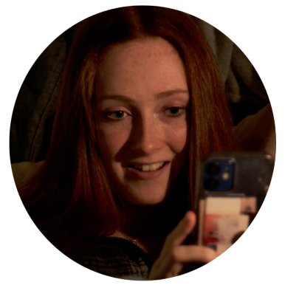
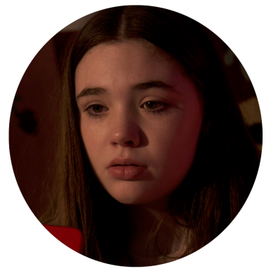
Upholding rights in relationships
Does Bella have the right to express her feelings on this as it affects her too?
Is Jade’s right to join a group just as important as Bella’s right to privacy?
How can Jade keep her right to attend the group whilst also respecting Bella’s rights?
Jade
Bella

Slide 10
Upholding rights even when it is difficult
Some things can make it harder for people to uphold each others’ rights in relationships, like when feelings are running high or we are feeling stressed.
What can people do in these situations?

Slide 11
Upholding rights even when it is difficult
Some things can make it harder for people to uphold each others’ rights in relationships, like when feelings are running high or we are feeling stressed.
What can people do in these situations?
Take a moment to notice if anyone’s rights are being broken
Think about whether there is anything they can do to change the situation
Communicate with their partner about the situation
Talk to someone they trust about the situation

Slide 12
Children’s rights
Revisit your mind map from the start of the lesson.
Are there any other rights you could add that young people have?
Add ideas about who a young person could go to if they felt that any of their rights were being broken.

