Slide 1
Being a positive bystander

Slide 2
Learning objectives and outcomes
Learning objective:
To understand what a positive bystander is and why it is important to be one
Learning outcomes:
I can identify ways to be a positive bystander in a range of situations
I can assess the things that can make it hard to be a positive bystander
I can explain why being a positive bystander is important

Slide 3
Ground rules
Use language that will not offend or upset anyone.
When you give an opinion, try to explain your reasons.
Listen to the views of others and show respect.
If you disagree, comment on what was said, not the person who said it.
Do not share personal information about other people.
If you’re worried about something that has happened to you or a friend, talk to a member of staff or an adult you trust after the session.
If a member of staff becomes aware of a risk to a young person’s safety, this information may need to be shared.

Slide 4
Beliefs activity
If a young person notices someone doing or saying something that could upset someone else, they should generally just mind their own business.
We all have a responsibility to care about other people.
In life people should stand up for each other more.
Offending someone is ok if it was meant to be a joke.

Slide 5
What is a positive bystander?
A bystander is someone who witnesses (sees or hears) something bad happening.
We will all be bystanders at some point in our lives, at these times we can either be:
A passive bystander: someone who chooses, for whatever reason, to ignore the bad thing or do nothing about it.
A positive bystander: someone who does something to try and improve the situation. Other names you might hear for this are being an ‘active bystander’ or an ‘ally’.

Slide 6
How to be a positive bystander
There are usually a range of things people can do to be positive bystanders
People can be positive bystanders by themselves, or as part of a group. Acting as part of a group is often called ‘collective action’
People can act as positive bystanders through body language, action or words
It doesn’t have to involve challenging the person/people in the moment, it might be something done afterwards
What people do will vary according to the situation, what is possible and what is safe.
For example, a young person may feel it is ok to challenge someone in their year group or below, but it may be less safe to directly challenge older people.

Slide 7
Can you think of an example of someone being a positive bystander?

Slide 8
What hurts the victim most is not the cruelty of the oppressor but the silence of the bystander.
Elie Wiesel
Courage calls to courage everywhere.
Millicent Fawcett
In the end we will remember not the words of our enemies, but the silence of our friends.
Martin Luther King
Can you think of any other reasons why it’s important to be a positive bystander?

Slide 9
Why is it important to be a positive bystander?
It can make communities and society better places.
Whenever one person stands up and says ‘wait a minute this is wrong’ it helps others do the same.
Research says that when a ‘bully’ is challenged, they are less likely to behave that way again.
Supporting someone in a difficult situation can improve their mental health.
It can help people to live up to their core values (what they believe is important in life).

Slide 10
Statements
Snitches get stitches
It’s only a joke
Mind your own business
[After saying or doing something that could upset someone]
For each statement, think about:
What does it mean?
What damage could it cause?

Slide 11
Being a positive bystander
Notes:
If video will not play on your device, use Vimeo version - https://vimeo.com/699070247, Password - BystanderNCA22

Slide 12
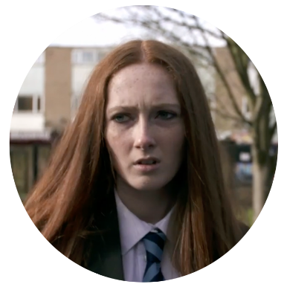
Being a positive bystander
What else could Jade and Jamie do to help the boy (Nathan) and be positive bystanders?
Jade
Jamie

Slide 13
How to be a positive bystander
Reporting: this may include telling a trusted adult, reporting to social media or websites, or reporting illegal activity to the police.
Changing the situation: this could be by distraction, changing the subject, or interrupting negative talk.
Body language: walking away or not joining in with bullying or negative conversations. Using facial expression to show you disagree or are unhappy with the conversation.
Supporting: talking to the person targeted or hurt, asking how you can support them. Calling for help when needed.

Slide 14
Closing activity
Complete the beliefs survey.
Rate your agreement with each of the statements.
After completing the beliefs survey, write down:
3 ways someone can be a positive bystander
2 reasons why being a positive bystander might be challenging
1 reason why being a positive bystander is important

